Slide 1
{{Company Name}}
AI Generated – job id: {{jobid}} – date: {{jobdate}}

Slide 2

Agenda Overview
General Overview
Leadership Team
Industry Position
Financial Performance
Products and Services
Corporate Social Responsibility
AI Generated – job id: {{jobid}} – date: {{jobdate}}
Notes:
--- We will begin with a general overview of the company, including its history and core values. Next, we will introduce the leadership team, followed by an analysis of the industry position. We will then review financial performance, discuss products and services, and conclude with corporate social responsibility efforts. Image source: Microsoft 365 content library

Slide 3
General Overview
AI Generated – job id: {{jobid}} – date: {{jobdate}}
Notes:
The general overview section will provide a foundational understanding of {{Customer Company}}. This includes its rich history, mission and vision, as well as the core values that shape its corporate culture.

Slide 4
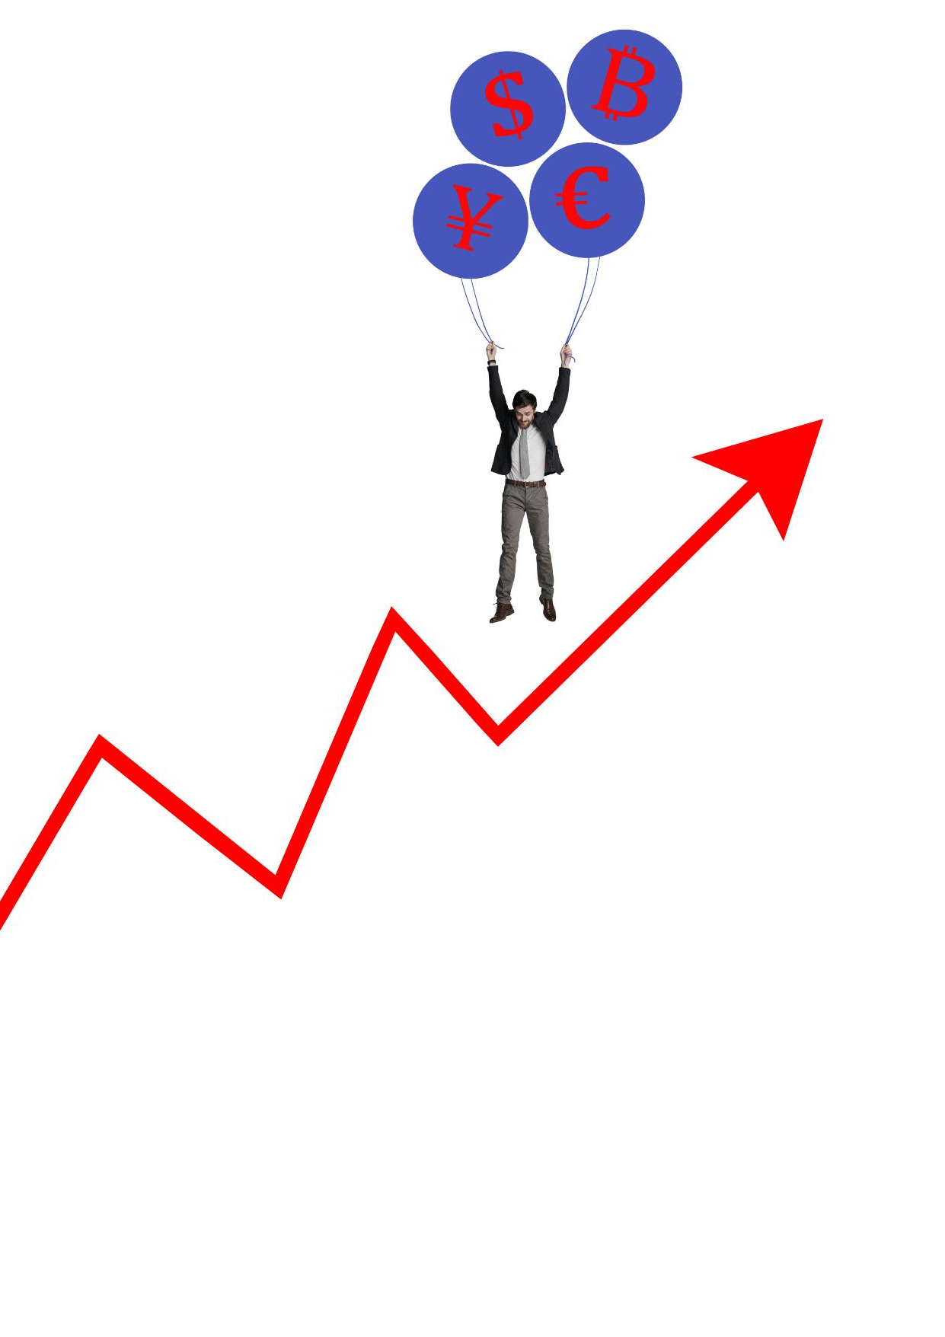
Company History and Background
{{Company History and Background}}
AI Generated – job id: {{jobid}} – date: {{jobdate}}
Notes:
--- {{Customer Company}} was founded in [Year] and has since evolved into a leader in its field. This slide will outline key milestones in its journey and the factors that contributed to its growth. Image source: Microsoft 365 content library

Slide 5

Mission and Vision Statements
Purpose of Mission Statement
The mission statement articulates the core purpose of the company, outlining its primary objectives and values.
Vision Statement Aspirations
The vision statement expresses the long-term aspirations of the company, serving as a source of inspiration and motivation.
Guiding Strategic Decisions
These statements serve as a framework for strategic decision-making, influencing the direction and priorities of the company.
AI Generated – job id: {{jobid}} – date: {{jobdate}}
Notes:
--- The mission and vision statements of {{Customer Company}} define its purpose and aspirations. This slide will elaborate on how these statements guide the company's strategic decisions and operations. Image source: Microsoft 365 content library

Slide 6

Industry insights
Industry: {{Industry}}
Position: {{Position in industry}}
Main competitors:
{{table_Main competitors}}
AI Generated – job id: {{jobid}} – date: {{jobdate}}
Notes:
--- {{Customer Company}} prides itself on its strong corporate culture, driven by core values such as integrity, innovation, and customer focus. This slide will explore how these values influence the work environment and employee engagement. Image source: Microsoft 365 content library

Slide 7
Leadership Team
AI Generated – job id: {{jobid}} – date: {{jobdate}}
Notes:
This section will introduce the leadership team of {{Customer Company}}. Their backgrounds and leadership philosophies are essential to understanding the company's strategic direction.

Slide 8

Organizational structure
{{Organizational Structure}}
{{table_Key Executives}}
AI Generated – job id: {{jobid}} – date: {{jobdate}}
Notes:
--- The executive team of {{Customer Company}} consists of experienced leaders with diverse backgrounds. This slide will provide an overview of their professional journeys and roles within the company. Image source: Microsoft 365 content library

Slide 9

Leadership Philosophy
Collaboration
Collaboration is a cornerstone of our leadership philosophy, facilitating teamwork and collective problem-solving.
Transparency
Transparency in decision-making fosters trust and open communication within the organization, ensuring everyone is informed.
Empowerment
Empowerment allows team members to take ownership of their work, leading to increased motivation and productivity.
AI Generated – job id: {{jobid}} – date: {{jobdate}}
Notes:
--- The leadership philosophy at {{Customer Company}} emphasizes collaboration, transparency, and empowerment. This slide will discuss how these principles are applied in decision-making processes. Image source: Microsoft 365 content library

Slide 10
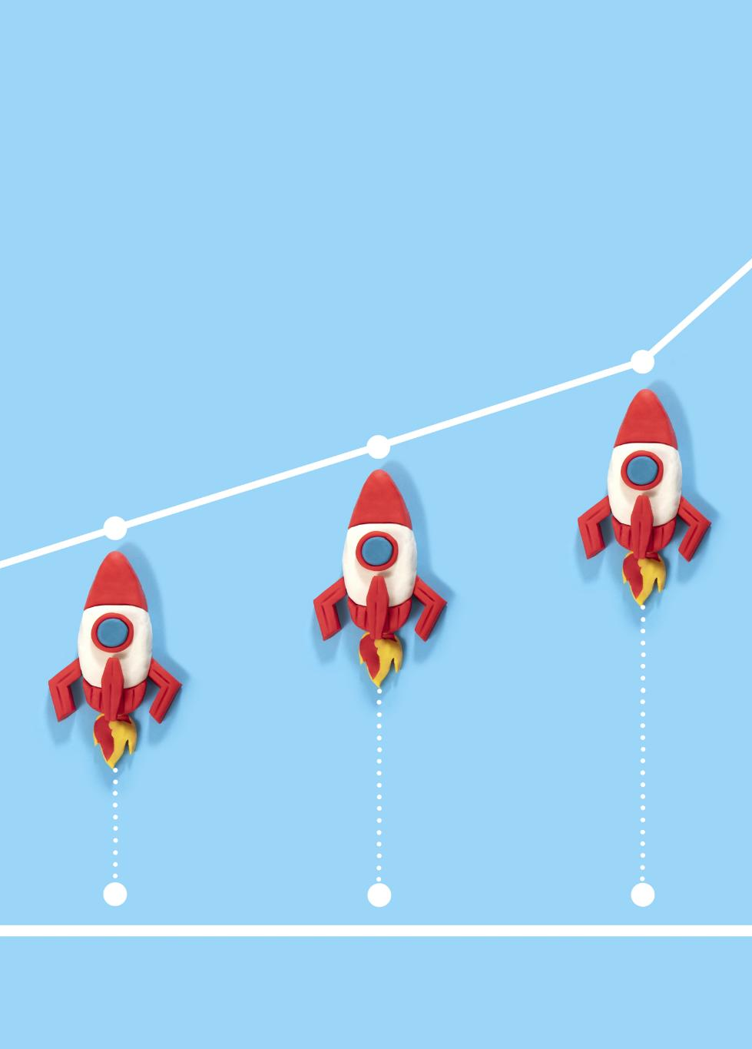
Key Achievements of Leadership
Milestone Achievements
The leadership team has guided the company to achieve key milestones that significantly enhance its market presence and operational efficiency.
Growth Impact
These achievements have positively impacted the company's growth trajectory, contributing to increased revenue and market share.
Enhanced Reputation
The leadership team's efforts have also bolstered the company's reputation within the industry, fostering customer trust and loyalty.
AI Generated – job id: {{jobid}} – date: {{jobdate}}
Notes:
--- Under the guidance of the leadership team, {{Customer Company}} has achieved significant milestones. This slide will highlight major achievements and their impact on the company's growth and reputation. Image source: Microsoft 365 content library

Slide 11
Industry Position
AI Generated – job id: {{jobid}} – date: {{jobdate}}
Notes:
Understanding the industry position of {{Customer Company}} is crucial for evaluating its market presence. This section will cover the primary industry, competitive landscape, and market share.

Slide 12
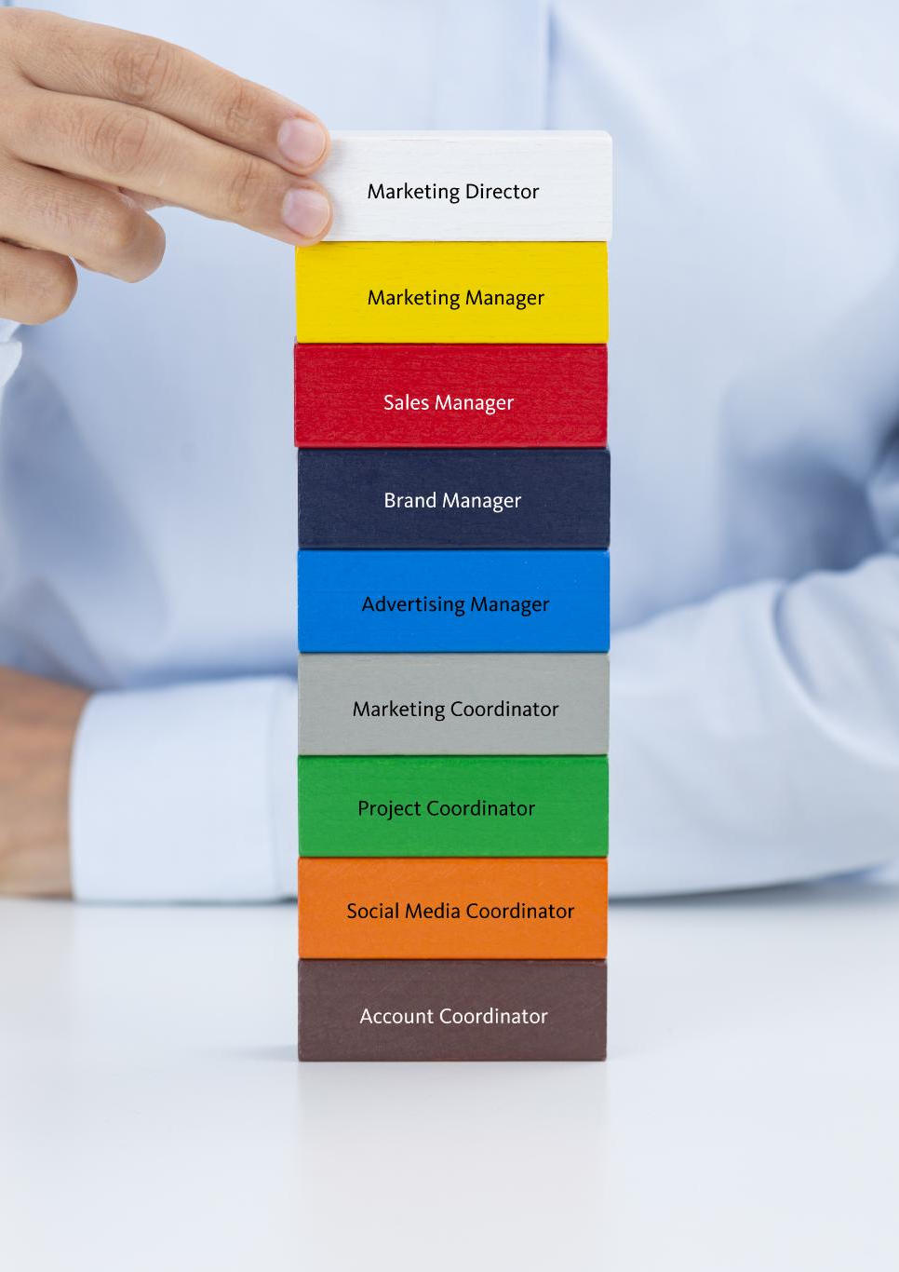
Primary Industry and Market Segments
Overview of Primary Industry
The primary industry is vital for economic growth, providing essential goods and services to various market segments.
Key Market Segments
Identifying key market segments allows for tailored strategies to meet the specific needs of customers.
Customer Needs Assessment
Understanding the specific needs of market segments is crucial for effective service delivery and customer satisfaction.
AI Generated – job id: {{jobid}} – date: {{jobdate}}
Notes:
--- {{Customer Company}} operates primarily in [Primary Industry]. This slide will detail the key market segments it serves and the specific needs of those segments. Image source: Microsoft 365 content library

Slide 13

Competitive Landscape
Dynamic Market Environment
The competitive landscape is constantly evolving due to market trends and consumer behavior changes.
Major Competitors Overview
Analyzing the key competitors helps understand their strengths and weaknesses in the market.
Differentiation Factors
Identifying the unique selling points (USPs) of {{Customer Company}} allows for better positioning against competitors.
AI Generated – job id: {{jobid}} – date: {{jobdate}}
Notes:
--- The competitive landscape is dynamic and ever-changing. This slide will analyze the major competitors of {{Customer Company}} and the factors that differentiate its offerings. Image source: Microsoft 365 content library

Slide 14

Market Share and Positioning
Importance of Market Share
Market share is a vital metric that reflects a company's competitiveness and success in the industry.
Positioning Strategies
Effective positioning strategies help companies differentiate themselves and capture a larger market share.
Insights into Market Dynamics
Understanding market dynamics is crucial for evaluating a company's performance and strategic direction.
AI Generated – job id: {{jobid}} – date: {{jobdate}}
Notes:
--- Market share is a critical indicator of success. This slide will provide insights into {{Customer Company}}'s market share and its positioning strategy in the industry. Image source: Microsoft 365 content library

Slide 15
Financial Performance
Notes:
Financial performance is key to assessing the health and sustainability of {{Customer Company}}. This section will cover revenue trends, recent results, and future projections.

Slide 16

Revenue and Profit Trends
Annual Revenue Growth
Analyzing the annual revenue growth to understand the company's financial performance over time.
Profit Margin Analysis
Examining profit margins to assess the company's profitability and operational efficiency.
Financial Trajectory Overview
A comprehensive overview of the financial trajectory, highlighting key trends and shifts in revenue and profit.
AI Generated – job id: {{jobid}} – date: {{jobdate}}
Notes:
--- This slide will illustrate the revenue and profit trends of {{Customer Company}} over the past few years, providing insights into its financial trajectory. Image source: Microsoft 365 content library

Slide 17

Recent Financial Results
Overview of Financial Results
This section provides a summary of the latest financial results that showcase the company's performance.
Key Metrics Highlighted
Key metrics such as revenue, profit margins, and expenses will be discussed to assess overall financial health.
Comparative Analysis
Comparisons with previous periods will help in understanding growth trends and financial stability.
AI Generated – job id: {{jobid}} – date: {{jobdate}}
Notes:
--- An overview of the most recent financial results will be presented here, highlighting key metrics such as revenue, profit margins, and expenses. Image source: Microsoft 365 content library

Slide 18

Financial Projections and Goals
Financial Projections Overview
This section provides an overview of the anticipated financial trajectory for the upcoming years.
Sustainable Growth Goals
We will outline the specific goals aimed at ensuring sustainable growth in the future.
Strategic Planning
Discussing the strategies in place to meet the financial goals and projections outlined.
AI Generated – job id: {{jobid}} – date: {{jobdate}}
Notes:
--- Looking ahead, this slide will discuss the financial projections for {{Customer Company}} and the goals set to achieve sustainable growth in the coming years. Image source: Microsoft 365 content library

Slide 19
Products and Services
AI Generated – job id: {{jobid}} – date: {{jobdate}}
Notes:
This section will provide an overview of the key products and services offered by {{Customer Company}}, showcasing its unique selling points and customer satisfaction.

Slide 20

Overview of Key Products/Services
Product Range
The company provides a variety of products tailored to different customer needs and preferences.
Service Offerings
Comprehensive services are available to enhance customer experience and satisfaction.
Customer-Centric Solutions
Innovative solutions are designed to address specific challenges faced by customers.
AI Generated – job id: {{jobid}} – date: {{jobdate}}
Notes:
--- {{Customer Company}} offers a diverse range of products and services designed to meet customer needs. This slide will provide an overview of the most significant offerings. Image source: Microsoft brand library

Slide 21
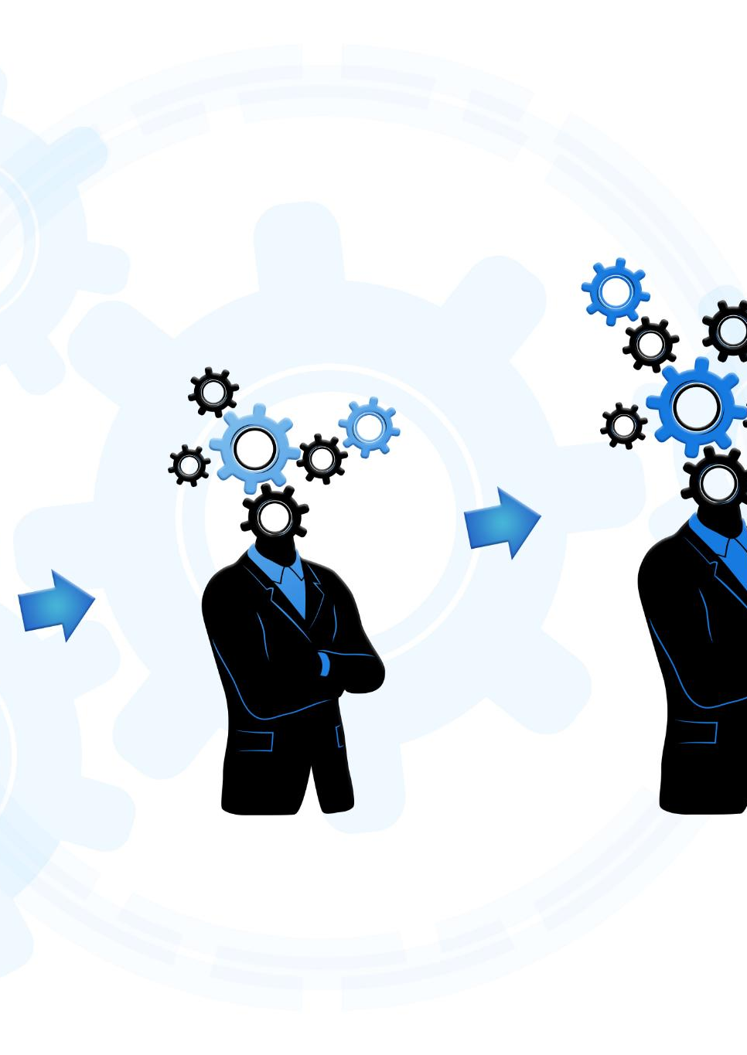
Unique Selling Points
Differentiation Strategy
The company’s differentiation strategy focuses on unique features that competitors do not offer, attracting customers.
Customer Engagement
Enhanced customer engagement through personalized services fosters loyalty and sets the company apart in the market.
Brand Reputation
A strong brand reputation built on quality and reliability attracts new customers and retains existing ones.
AI Generated – job id: {{jobid}} – date: {{jobdate}}
Notes:
--- What sets {{Customer Company}} apart from competitors? This slide will explore its unique selling points that enhance customer loyalty and market appeal. Image source: Microsoft 365 content library

Slide 22

Customer Base and Satisfaction
Customer Demographics
Analyzing the demographics of the customer base helps tailor services and marketing strategies effectively.
Customer Satisfaction Insights
Evaluating customer satisfaction levels provides insights into areas for improvement and enhancement of services.
Importance of Feedback
Customer feedback is vital for understanding their needs and improving overall experiences with the company.
AI Generated – job id: {{jobid}} – date: {{jobdate}}
Notes:
--- Understanding the customer base is crucial. This slide will delve into the demographics of {{Customer Company}}'s customers and provide insights into customer satisfaction levels. Image source: Microsoft 365 content library

Slide 23
Corporate Social Responsibility
AI Generated – job id: {{jobid}} – date: {{jobdate}}
Notes:
Corporate social responsibility (CSR) plays a vital role in the reputation of {{Customer Company}}. This section will explore its initiatives in sustainability and community engagement.

Slide 24
Sustainability Initiatives
Renewable Energy Use
The company focuses on integrating renewable energy sources to reduce reliance on fossil fuels and lower emissions.
Waste Reduction Programs
Initiatives aimed at minimizing waste through recycling and composting, promoting a circular economy.
Water Conservation Efforts
Implementing strategies to conserve water, including efficient usage and rainwater harvesting systems.
AI Generated – job id: {{jobid}} – date: {{jobdate}}
Notes:
--- {{Customer Company}} is committed to sustainability through various initiatives aimed at reducing its environmental footprint. This slide will outline the key sustainability efforts in place. Image source: Microsoft 365 content library

Slide 25

Community Engagement
Building Relationships
Engaging with the community fosters strong relationships and trust, essential for successful partnerships.
Community Activities
A variety of community engagement activities can include workshops, events, and volunteer opportunities.
Partnerships for Impact
Collaborative partnerships with local organizations and stakeholders can amplify community engagement efforts.
AI Generated – job id: {{jobid}} – date: {{jobdate}}
Notes:
--- Engaging with the community is essential for building strong relationships. This slide will highlight the various community engagement activities and partnerships initiated by {{Customer Company}}. Image source: Microsoft brand library

Slide 26

Corporate Philanthropy
Importance of Corporate Philanthropy
Corporate philanthropy enhances a company’s image while contributing positively to society and the environment.
Impact on Communities
Philanthropic efforts provide essential support to community programs, education, and healthcare initiatives.
Employee Engagement
Engaging employees in philanthropic activities boosts morale and fosters teamwork and collaboration.
Long-term Sustainability
Corporate philanthropy contributes to sustainable development by addressing social issues and environmental challenges.
AI Generated – job id: {{jobid}} – date: {{jobdate}}
Notes:
--- Corporate philanthropy is an important aspect of CSR. This slide will showcase the philanthropic efforts of {{Customer Company}} and their impact on society. Image source: Microsoft 365 content library

Slide 27
Conclusion
Foundational History
Understanding the foundational history of the company is crucial for recognizing its evolution and core values.
Current Industry Standing
Analyzing the current industry standing allows for insight into competitive positioning and market presence.
Future Goals
Identifying future goals and objectives can guide strategic decisions and support sustained growth.
AI Generated – job id: {{jobid}} – date: {{jobdate}}
Notes:
In conclusion, this comprehensive overview has highlighted the key aspects of {{Customer Company}}, from its foundational history to its current industry standing and future goals. Understanding these elements can help inform strategic decisions and foster continued growth.

